Slide 1
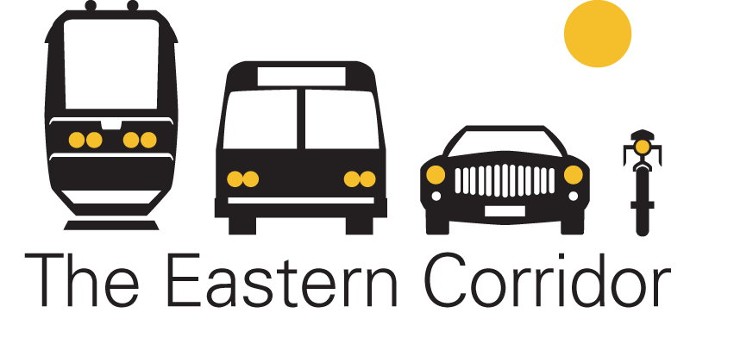

STATE ROUTE 32 RELOCATION
COMMUNITY UPDATE
Mariemont Elementary School
January 22, 2012
6:00 p.m. to 8:00 p.m.

Slide 2
Purpose of Tonight’s Meeting
An informational session to provide an update on the SR 32 Relocation project and provide clarification
  Will include a presentation and Q&A session
Will discuss:
  Feasibility Study findings and recommendations
  Project development and decision making processes
  Next steps
  Community Partners Committee (CPC)
  Section 106
  Oasis Rail Transit project

Slide 3
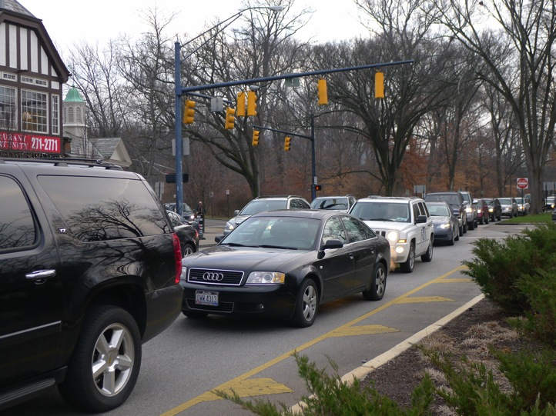
Eastern Corridor Transportation Issues
Existing roads can’t support travel demand.
Indirect routes, poor connectivity
Few travel options
Inefficient movement of
goods, services, people
Economic development is
hindered
Environment affected by
growing congestion
If No Build Alternative is chosen, these conditions will continue and get worse

Slide 4
Where We Have Been
Extensive planning has occurred over the past decades
Planning-level decisions have been carried forward based on appropriate levels of analyses and public input
All projects are still in the development – or fact finding – stage
Working toward identifying a preferred alternative
Current process drills down into the details
Transportation Problems
Transportation Problems
Transportation Problems
Transportation Problems
Transportation Problems
Major Investment Study
Land Use Vision Plan
Green Infrastructure Master Plan
Tier 1 Environmental
Impact Statement (EIS)
Tier 1 EIS
Record of Decision
Project Studies,
Plan Updates
Tier 2
Project
Studies
Major Investment Study
Major Investment Study
Land Use Vision Plan
Green Infrastructure
Master Plan
Major Investment Study
Land Use Vision Plan
Green Infrastructure Master Plan
Tier 1 Environmental
Impact Statement (EIS)
Tier 1 EIS
Record of Decision
Preferred Alternative
Notes:
Drills down into details to define with clarity and X to . . . .

Slide 5
Eastern Corridor Program
Implemented together, Eastern Corridor projects will:
Address capacity and safety
Improve regional connectivity, access
Accommodate future growth
Provide travel alternatives to driving
Improve connections to jobs and markets
Eastern
Corridor Program
Red Bank Corridor
Project
Oasis Rail Transit
Project
SR 32 Relocation
Project
SR 32 Improvements,
Eastgate Area
Current Eastern Corridor projects also include:
Local roadway network improvements
Expanded bus transit
Accommodations for bicyclists,
pedestrians

Slide 6
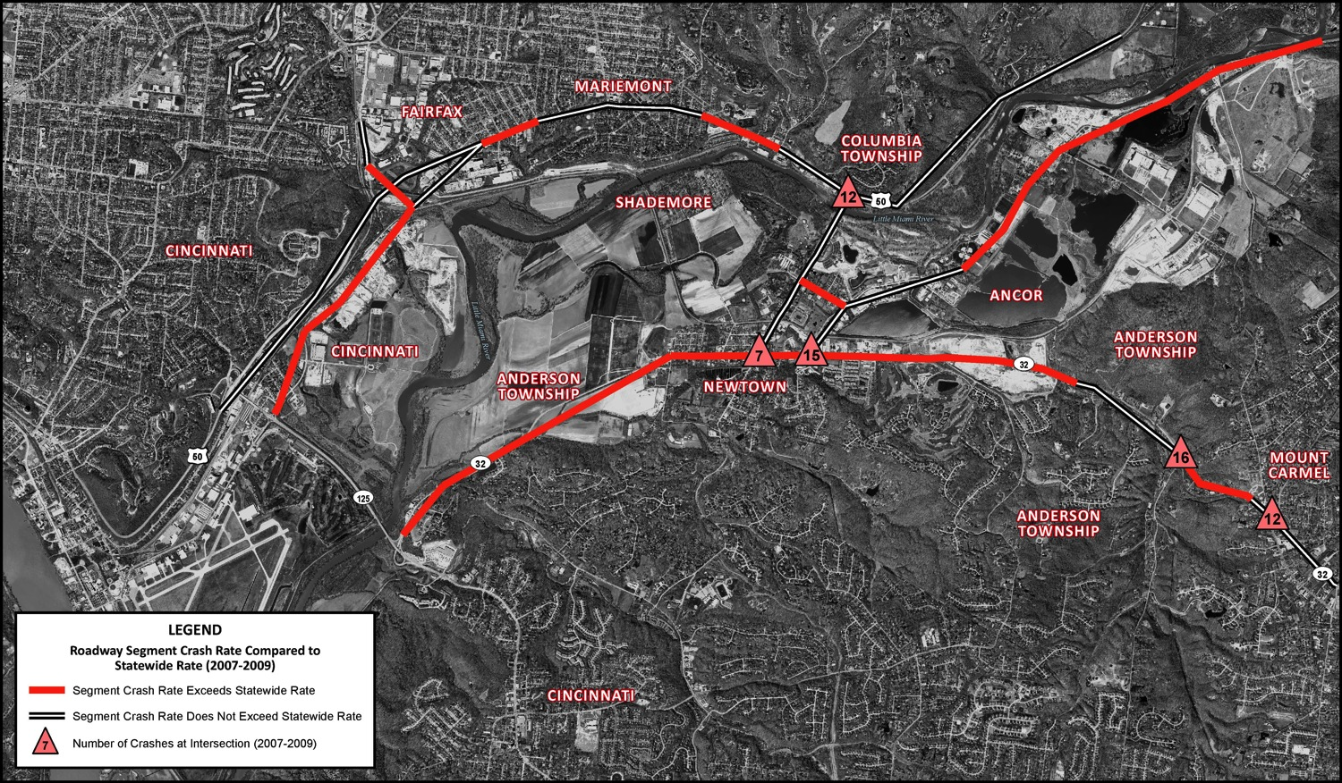
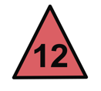
SR 32 Relocation Study Area – Accident Rates
MARIEMONT
FAIRFAX
NEWTOWN
LEGEND
= Indicates where accident
rates exceed statewide rates
= Number of crashes at
intersections (2007-2009)
2007 – 2009 Crash Data for the Primary Road Network in Segment II/III, July 2012.
From the SR 32 Relocation Feasibility Study, Figure X

Slide 7
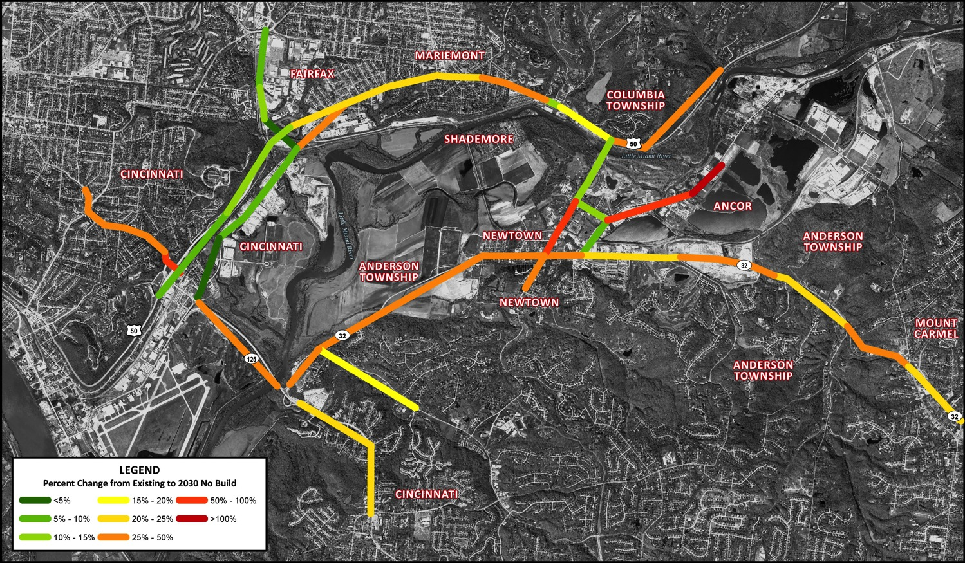
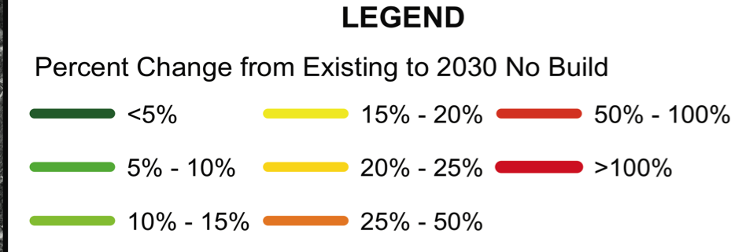
Future No Build Traffic Volumes
MARIEMONT
FAIRFAX
NEWTOWN
Percent Change in Average Daily Traffic from Existing to 2030, No Build Scenario. Updated July 2012.
Notes:
Traffic is being updated

Slide 8
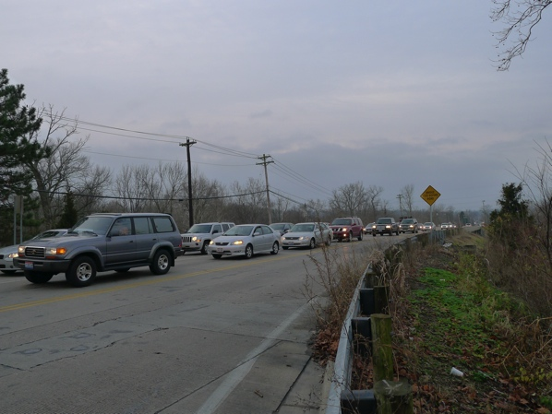
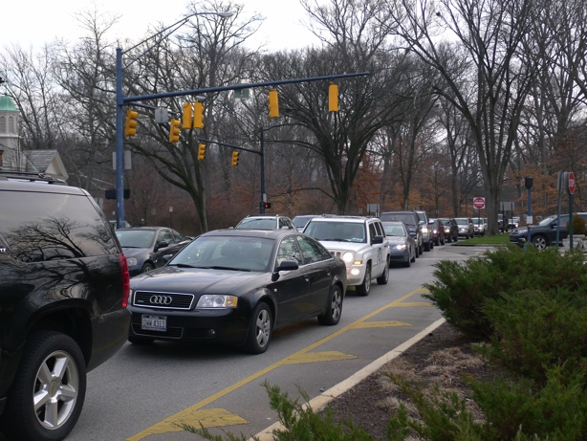
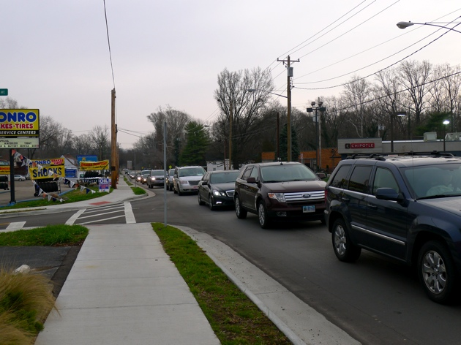
Future No Build Traffic Projections
Newtown Road at Wooster Pike/US 50
Wooster Pike/US 50 and Miami Road
Wooster Pike/US 50 at Simpson Avenue
Source: SR 32 Relocation Feasibility Study, March 2013. Values shown represent the projected increase in average daily traffic volume along Wooster Pike/US 50, between Belmont Avenue and Miami Run.
Notes:
Means 4,600 more cars per day on this section of Wooster Pike
Do we have data on historical growth on this road

Slide 9
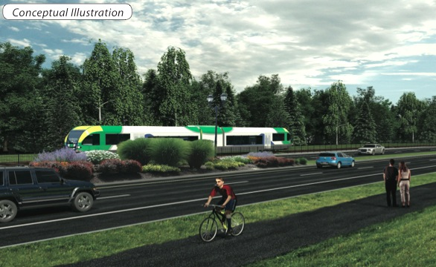
Vision for Relocated SR 32
Boulevard-like; not a highway like I-71, Cross County
Two lanes each direction
Managed access points
Options
  Possible landscaped median
  Bike/walking path along one side
  Possible rail line on other side
* Actual layout to be determined and will depend on
alignment, geology, topography, community preference, etc.
Notes:
Erie Avenue in portions of Hyde Park
Wooster Pike in Terrace Park
Wooster Pike in Mariemont
Victory Parkway
Central Parkway

Slide 10
Where Are We in the Process?
WE ARE HERE
Planning
Tier 1 - Preliminary Engineering/ Environmental
Detailed Plans/ROW
Construction
Tier 2 - Preliminary Engineering/
Environmental
Tier 2 Preliminary Engineering/Environmental Components:
Complete Feasibility Study –
Narrow down Tier 1 preliminary corridors
Develop alternative alignments
Begin National Environmental Policy Act (NEPA) studies – identify impacts of alignments
Update cost estimates
Alternative Evaluation Report – Identify a preliminary preferred alternative
Decision Point
Includes:
Partner Coordination
Community input/
Public involvement
Regulatory agency
coordination

Slide 11
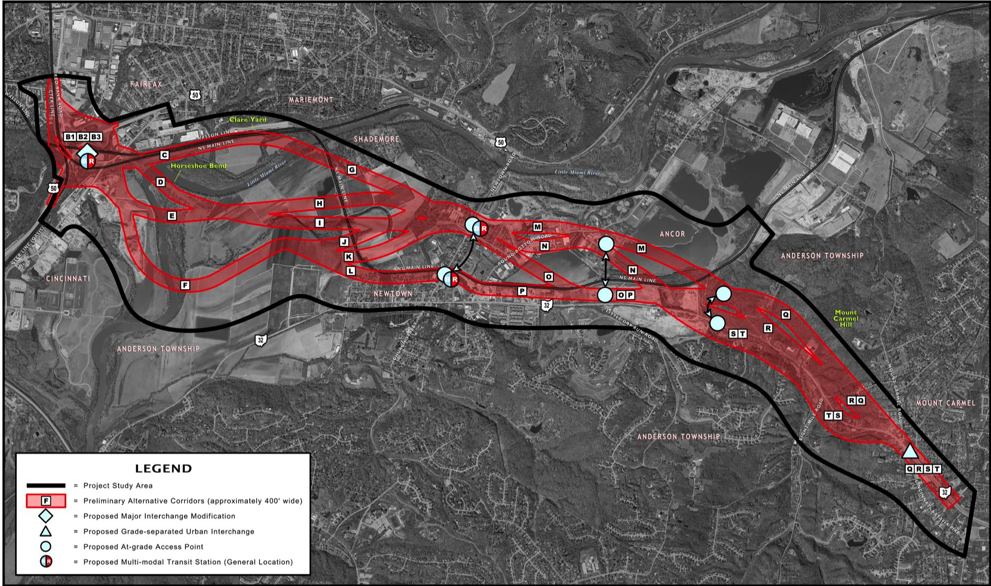
Tier 1 Proposed Corridors
MARIEMONT
FAIRFAX
ANCOR
NEWTOWN
LEGNED
LEGEND
= Project Study Area
= Preliminary Alternative
Corridors
Map Source: SR 32 Relocation Project Feasibility Study, March 2012. Figure 4.

Slide 12
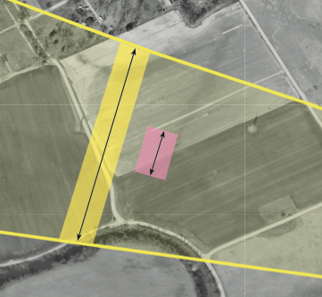
Study Corridor vs. Alignment
Study Corridor
  Wide study area in which specific alignments will be developed
  May contain multiple alignment possibilities
  Is typically much wider – by several hundred feet – than the actual road
Alignments
  Actual footprint
  Width depends on components (road, rail, bike/walking paths, shoulders, medians, etc.)
Sample
CORRIDOR
Width
Sample
ALIGNMENT
Width*
*Note: Location of alignments are not yet
determined. Location in image is shown for illustration purposes only.

Slide 13
SR 32 Relocation Feasibility Study
Further evaluated the preliminary project corridors advanced in Tier 1 EIS
Recommended elimination of many corridors due to impacts, costs, engineering constraints and other considerations
Recommended several corridors for further consideration and analysis
A preferred corridor was not identified

Slide 14
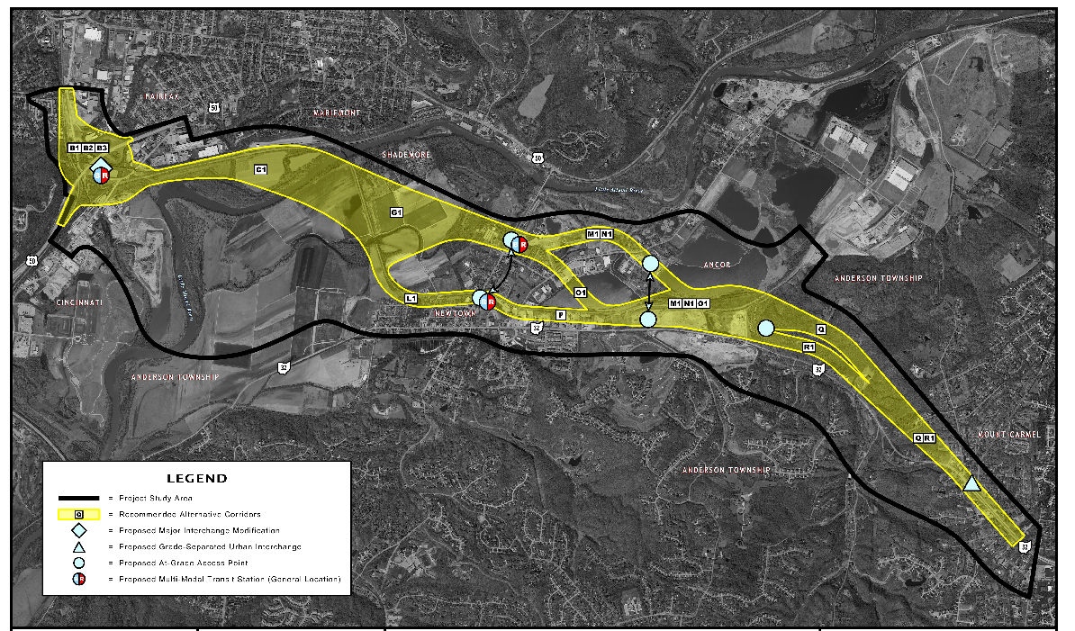
Corridors for Further Study - Mar. 2012
MARIEMONT
FAIRFAX
ANCOR
CORRIDOR L1/P
IS RAIL ONLY,
AND FOLLOWS EXISTING ALIGNMENT
LEGEND
= Project Study Area
= Corridors recommended for further study
Map Source: SR 32 Relocation Project Feasibility Study, March 2012. Figure 17.

Slide 15
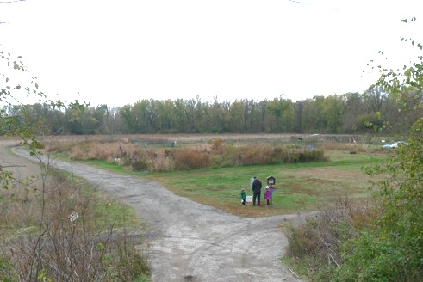
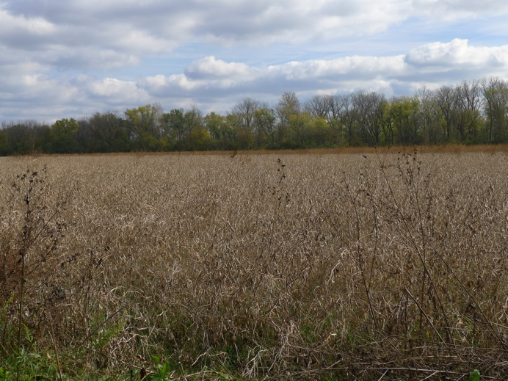
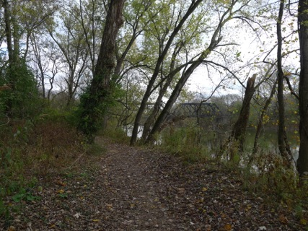
Mariemont South 80
2006 – Area identified as a public use space in Tier 1 FEIS
A review of Feasibility Study and Phase 1 history/architecture studies in 2012 clarified that:
  Site is included within the Mariemont National Historical Landmark boundary
  Village of Mariemont is now developing/using site for recreation

Slide 16
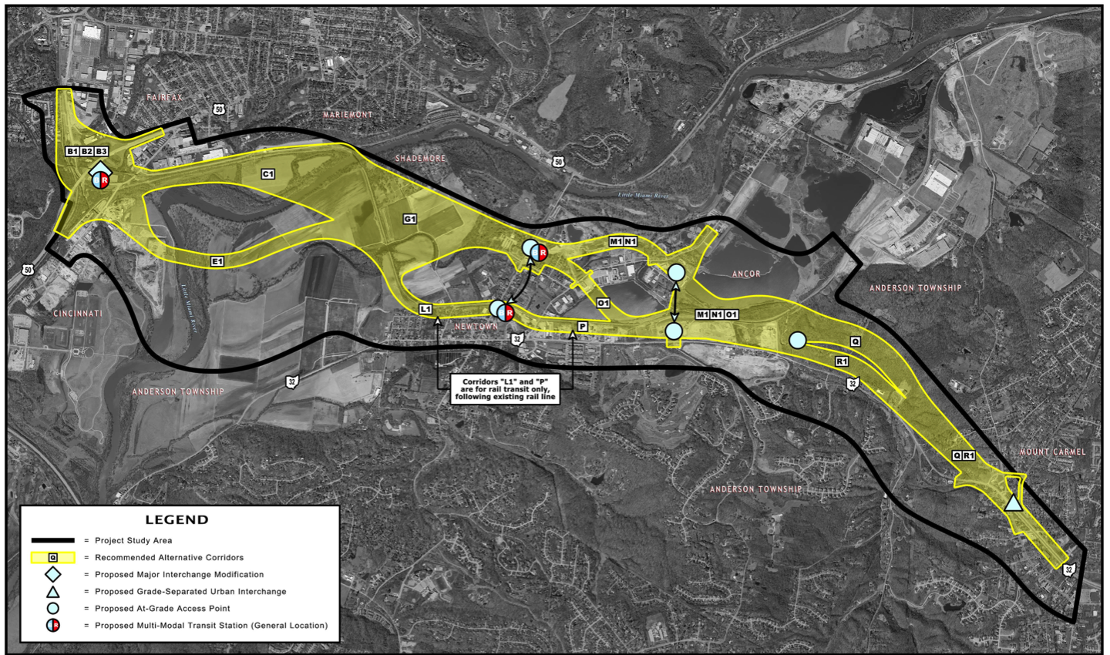
Updated Corridors for Further Study – Dec. 2012
MARIEMONT
FAIRFAX
ADDED SOUTHERN CORRIDOR
CORRIDOR L1/P
IS RAIL ONLY
LEGEND
= Project Study Area
= Corridors recommended for further study
ANDERSON TOWNSHIP
Map Source: SR 32 Relocation Project Feasibility Study ADDENDUM, Dec. 2012.
Attachment D – Figure 17 (Revised).
Notes:
Why select this corridor?
Feasibility studies in Tier 1
Public Input
Geomorphological work that show the most stable parts
It’s at least acceptable and technically feasible

Slide 17
Corridor Selection Considerations
Little Miami River’s (LMR) National and State Scenic River designation requires protection and enhancement of:
  Free-flowing character
  Water quality
  Scenic (aesthetic), recreational, fish and wildlife, geological and historical values
Clear-span bridge commitment resulted from coordination with Ohio Dept. of Natural Resources, the National Park Service and other agencies
Public input

Slide 18
Corridor Selection Considerations
Geomorphological assessments and hydraulic modeling identified suitable/unsuitable areas for river crossing based on:
  Channel stability
  Anticipated length of clear-span bridge
  Constraints to design cost
Two options:
  Upstream of horseshoe bend – LMR stable
  Upstream of Clear Creek (downstream of horseshoe bend) – LMR moderately stable
  Other areas were classified as less stable or unstable

Slide 19
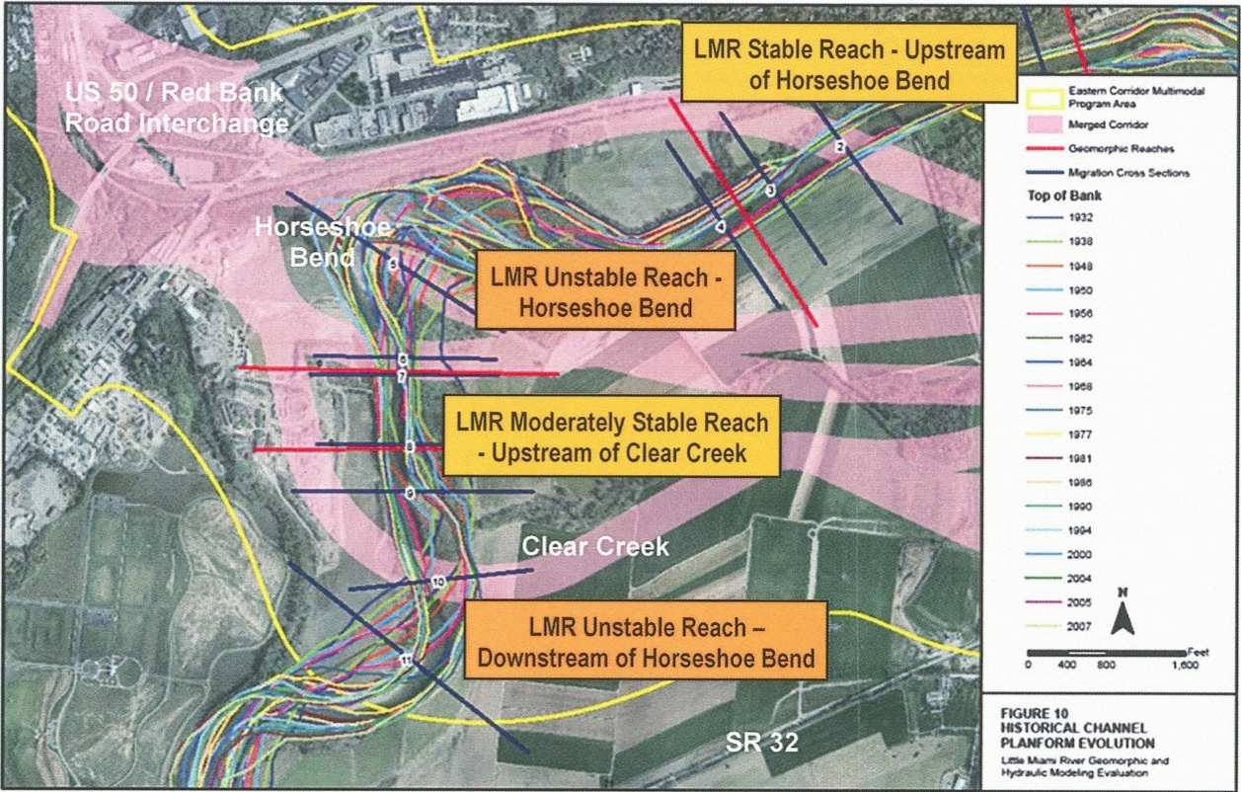
Considerations – Channel Stability
LMR Stable Reach – Upstream of Horseshoe Bend
Colored lines on map indicate paths of the
Little Miami River between 1932 and 2007.
Map Source: SR 32 Relocation Project Feasibility Study, March 2012.
Figure 7 – Little Miami River Channel Studies.

Slide 20
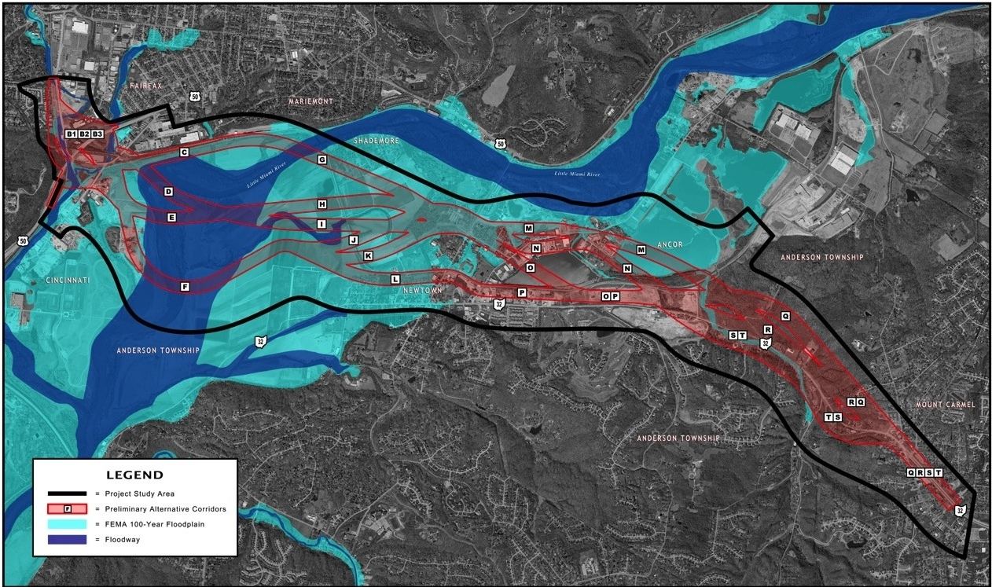

Considerations – Floodplains/ways
FAIRFAX
MARIEMONT
ANCOR
NEWTOWN
LEGEND
= Project Study Area
= Preliminary Alternative Corridors
= FEMA 100 Year Floodplain
= Floodway
Map Source: SR 32 Relocation Project Feasibility Study, March 2012. Figure 9 – Floodplains and Floodways.

Slide 21
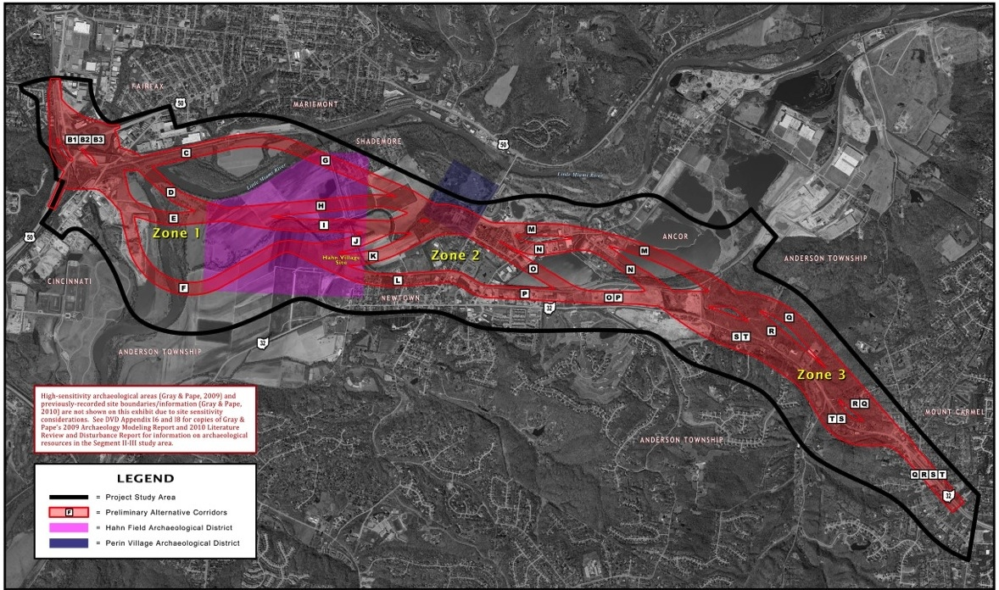
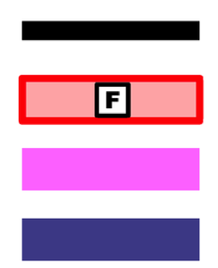
Considerations –
Existing Nat’l Register Archaeology Districts
MARIEMONT
FAIRFAX
ANCOR
NEWTOWN
LEGEND
= Project Study Area
= Preliminary Alternative Corridors
= Hahn Field Archaeological District
= Perin Village Archaeological District
Map Source: SR 32 Relocation Project Feasibility Study, March 2012. Figure 13 – Archaeological Sensitivity.
Notes:
Explain why Lower 80 not included
There are other studies being performed in project area. As new information is collected and approved by SHPO, it will be updated accordingly.

Slide 22
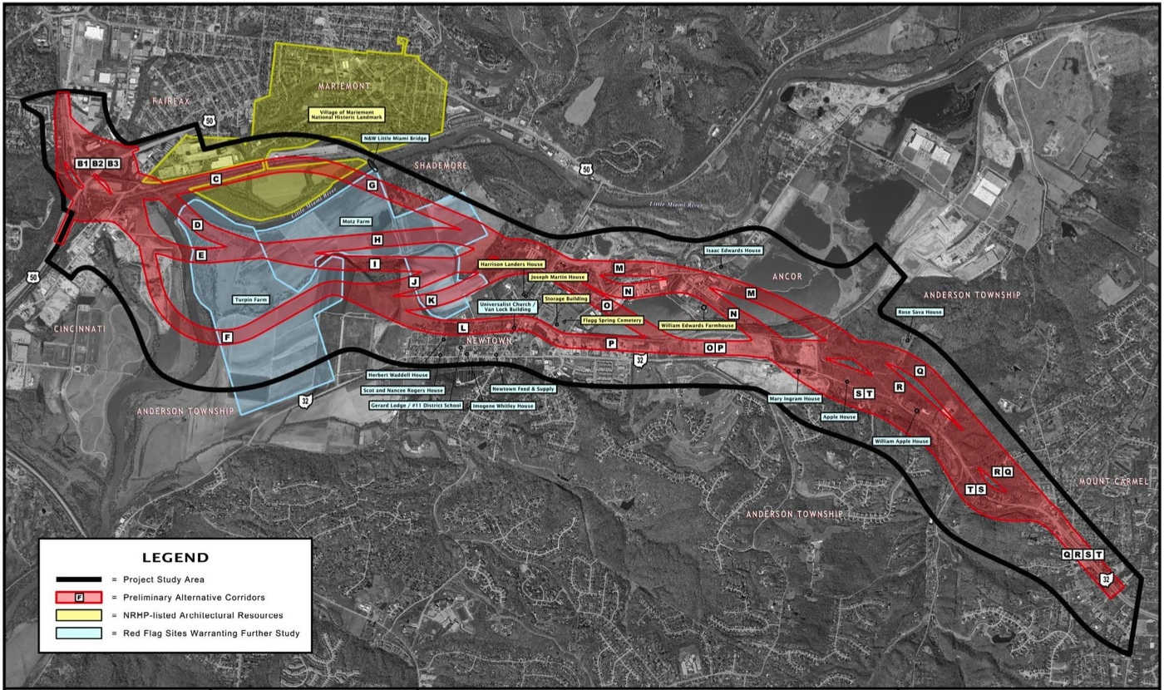
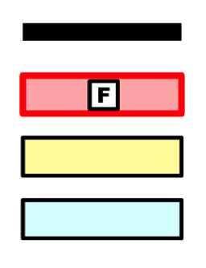
Considerations – Historic Resources
MARIEMONT
FAIRFAX
ANCOR
NEWTOWN
LEGEND
= Project Study Area
= Preliminary Alternative Corridors
= NRHP-listed Architectural Resources
= Red Flag Sites Warranting Further Study
Map Source: SR 32 Relocation Project Feasibility Study ADDENDUM, Dec. 2012.
Attachment B: Figure 12 (Revised) – History/Architecture Resources.
Notes:
Note that lower 80 acres has been added in. This update has been made in Feasibility Study report and official documentation

Slide 23
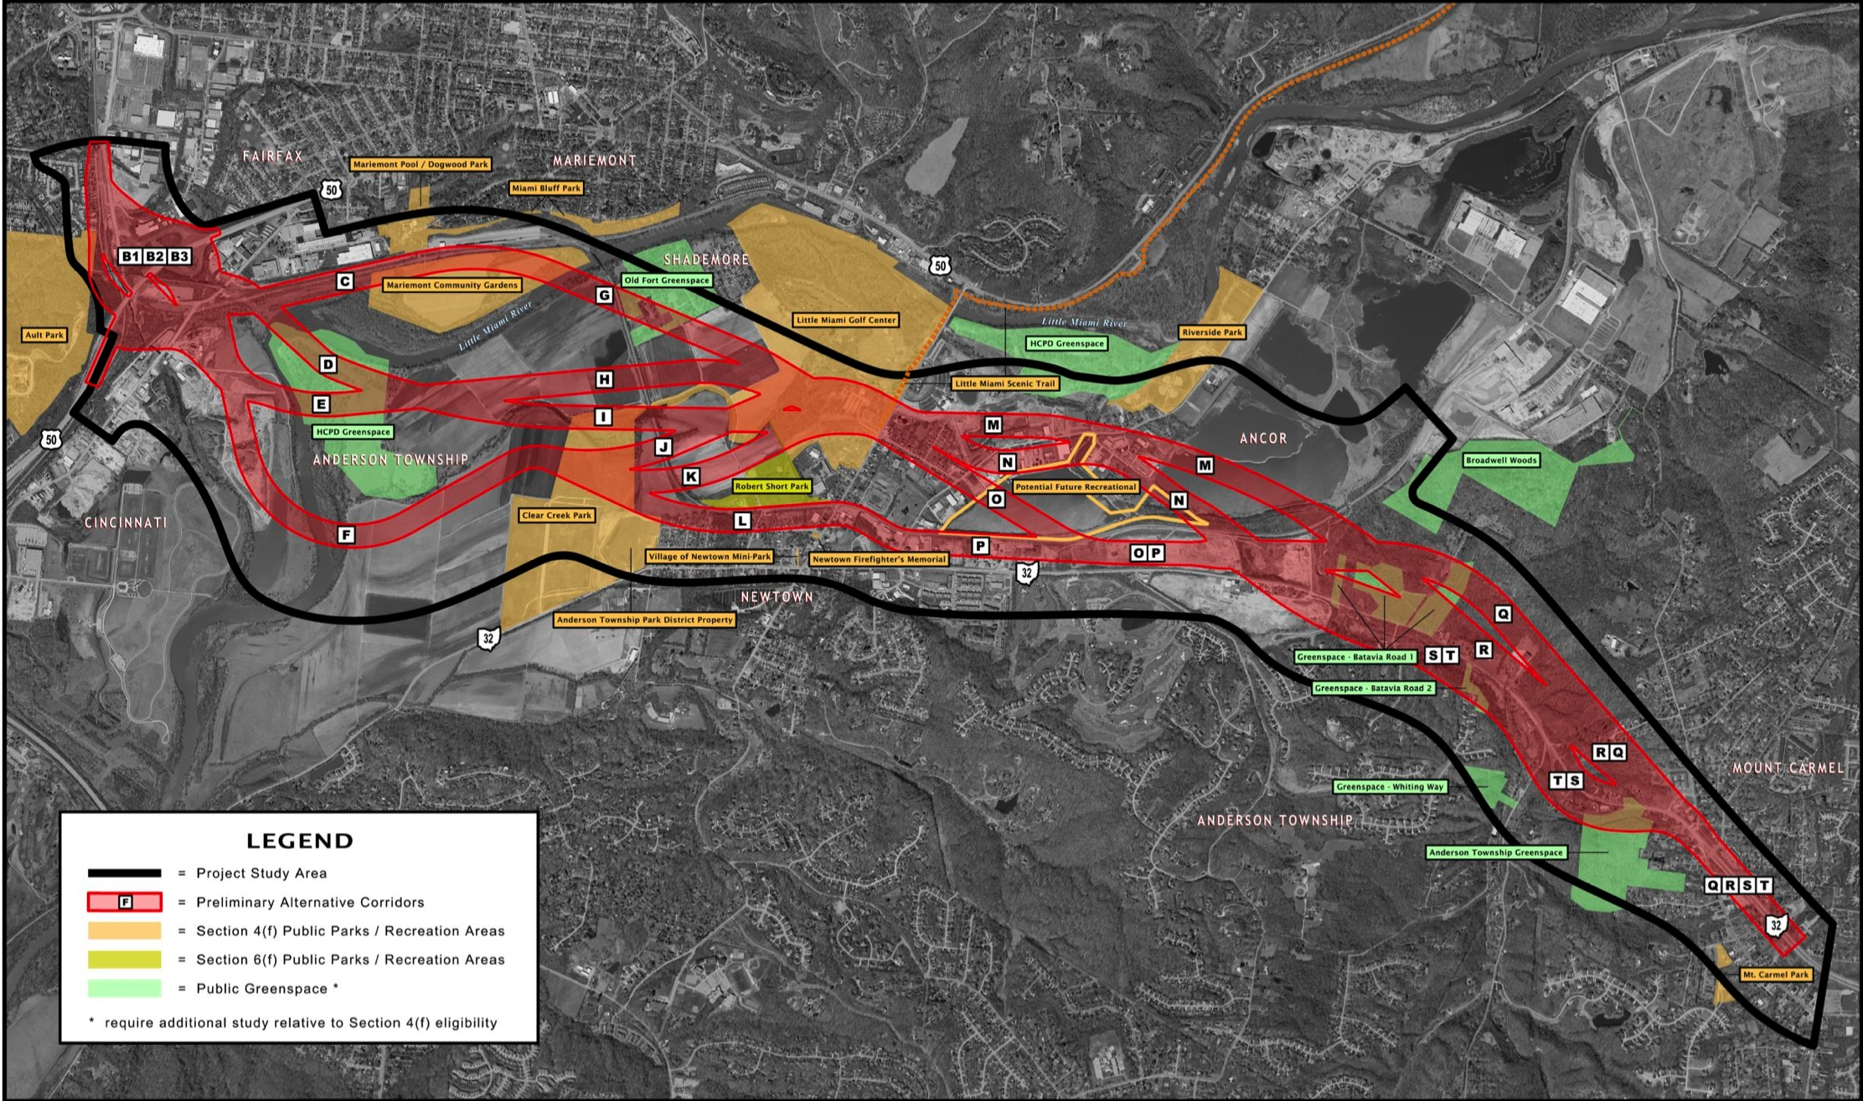

Considerations – Greenspace
MARIEMONT
FAIRFAX
ANCOR
NEWTOWN
LEGEND
= Project Study Area
= Preliminary Alternative Corridors
= Section 4(f) Public Parks/Recreation Areas
= Section 6(f) Public Parks/Recreations Areas
= Public Greenspace*
* Requires additional study relative to Section 4(f) eligibility
Map Source: SR 32 Relocation Project Feasibility Study, March 2012. Figure 14 – Public Parks and Greenspace.
Notes:
Considering context sensitive solutions – being sensitive to context in which we develop solutions; makes project nicer for community; design elements that fit community character

Slide 24
Other Considerations
Ecological features – streams, wetlands, endangered species
Landslide prone areas – Miami Bluff, Mt. Carmel
Business and residential impacts
Hazardous materials
Structures – LMR/floodway crossing
Alignment elevation issues – floodplain, Mt. Carmel
Access points - US 50, Church Street, Ancor, etc.
Landfills and gravel pit lakes
Rail transit and station locations
Development/re-development opportunities
Construction costs

Slide 25
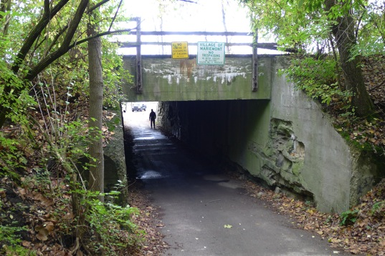
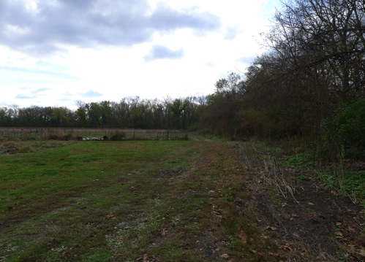
South 80 Assistance Opportunities
If route affects South 80 Trails area, there is opportunity to invest in enhancements:
Access improvements
Bikeways/paths
Basket of ideas in the Vision 2021 Plan
Others to be identified through community involvement
Notes:
We are going to complete the necessary studies to see what the feasible options are.
Whichever route chosen, there will be impacts and we will also be looking at ways to minimize and mitigate
We don’t know what you want—we won’t presume to tell you. That decision is up to you and then we can see what’s possible

Slide 26
Next Steps
Work with communities, regulatory agencies:
  Community Partners Committee (CPC) meetings
  Section 106 Consultation meetings
  Other meetings as needed
Meet to identify issues, explore options
Finalize recommended corridors for further study
Timeframe: Early 2013
Notes:
After Timeframe bullet, say that we will then be looking at alignment alternatives

Slide 27
Community Partners Committee Role
Represent communities to:
Provide feedback – Share questions, concerns, comments about project information, studies, and recommendations
Collaborate in problem solving – Provide input/ideas to be considered in developing alternatives and solving project issues
Be a link to the larger community – Relay community feedback to project team; provide Eastern Corridor updates to community
Notes:
Focus on efforts of Mariemont community’s formation of CPC as well as other nearby communities including Newtown . . . is currently developing a CPC to work with the project team in upcoming weeks

Slide 28
Section 106 Consultation Meetings
National Historic Preservation Act: Federal actions must consider effects on historic/archaeological resources, above and below ground
Section 106 activities will:
  Identify historic/archaeological resources
  Identify, evaluate, mitigate impacts
  Document the process in a Memorandum of Agreement
Initial Section 106 meetings to provide Advisory Council on Historic Preservation, Ohio Historic Preservation Office, Native American Tribes, National Park Services, other Section 106 consulting parties opportunity to comment
Initial meetings targeted for February 2013
Notes:
Purpose and intent is narrowly confined to a particular set of issues that are connected to a larger set
Consulting parties- is a focus group made of individuals with interest and expertise in cultrual resource area

Slide 29
Decision Making Process
ODOT follows federal NEPA requirements
Outcome is not predetermined
Process is designed to identify with clarity and detail the benefits and impacts of alternatives
Information gathered through in-depth studies, analysis, and public involvement provide the details necessary to make informed decisions
By completing the process, we will be confident that we explored all possible options
Notes:
Outcome is not predetermined
ODOT’s PDP follows federal NEPA process
Requires detailed assessment of environmental and community impacts
Process is designed to identify with clarity and detail the benefits and impacts of alternatives that best fulfill project needs
Requires detailed assessment of environmental and community impacts
Involves alternatives development and analysis
Identifies measures to avoid or reduce negative impacts
Includes stakeholder and public input at every phase of development
Information gathered through in-depth studies, analysis, and public involvement provide level of detail needed to make an informed decision

Slide 30
Decision Making Process
Includes public, stakeholder input in every phase of development
  Formal – Public involvement meetings, public hearings (if needed)
  Informal – Tonight’s meeting, Community Partners Committees, community presentations, contacts through Facebook, email, telephone hotline
Community partner participation in development process
  Eastern Corridor Implementation Partners – Guide project development and decisions; assist with project funding
  Eastern Corridor Development Team and Community Partner Committees – Provide important community input that is considered in decision-making
  Public involvement – Provides individual stakeholder input

Slide 31
Decision Making Process
The Decision Makers
  Project decisions made by Federal Highway Administration (FHWA), ODOT, in coordination with regulatory agencies within the NEPA process
  FHWA is lead agency
  FHWA issues Record of Decision
Notes:
Decision Makers include a dozen other federal agencies
Department of Interior, National Park Service
National Historic Landmark Program
National Wild and Scenic Rivers
US Fish and Wildlife
ODNR
US Fish and wildlife
EPA

Slide 32
Questions and Comments
www.EasternCorridor.org
EasternCorridor@EasternCorridor.org

Slide 33
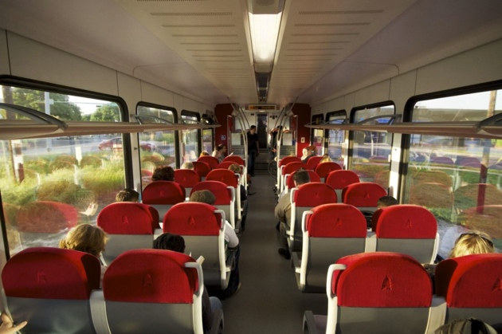
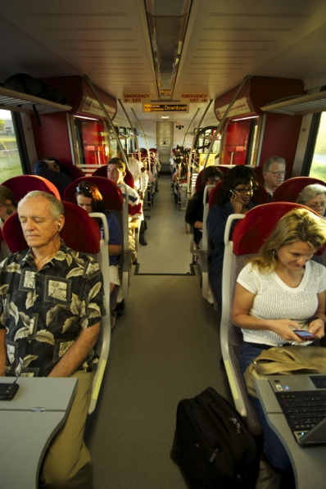
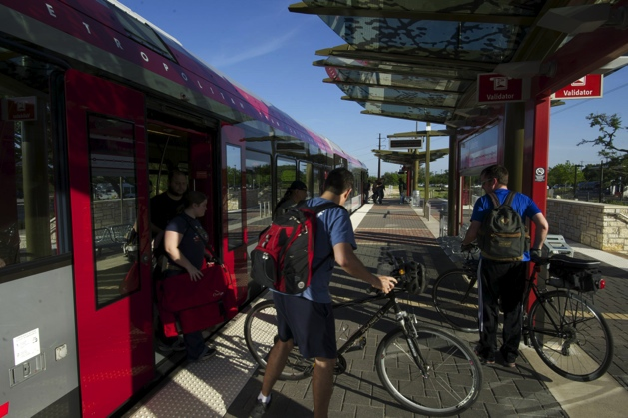
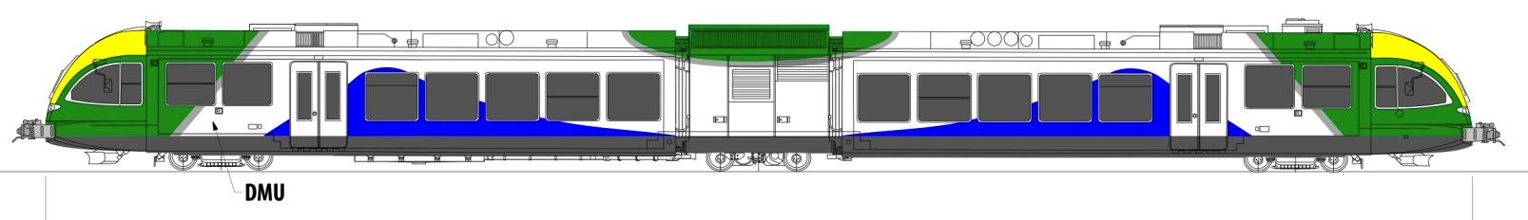
Oasis Rail Transit – At A Glance
New transportation alternative
Will serve residents, workers and visitors between downtown Clermont County and communities in between
Is a foundation upon which future passenger rail lines can be added

Slide 34
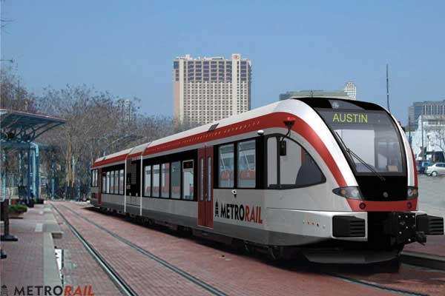
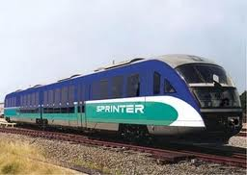
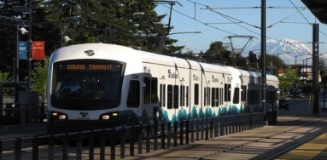
Oasis Project Elements
Evaluate alignment options; identify locally-preferred alternatives
Determine vehicle type
Develop ridership projections
Conceptual operations plan
Evaluate/select station locations
Develop conceptual station area plans
Prepare cost estimates,
conceptual financing plan
Complete Business Case Assessment

Slide 35
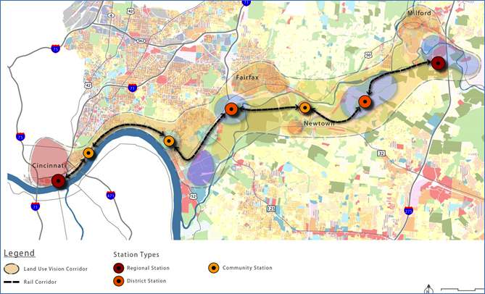
Oasis Rail Station Locations
Proposed Locations
  Riverfront Transit
  Center (RTC)
  Boathouse
  Columbia
  Tusculum area*
  Fairfax area*
  Newtown area*
  Ancor area*
  Milford area*
  * Specific station locations for starred stations have not yet been determined. Locations indicated on map are representative only.

Slide 36
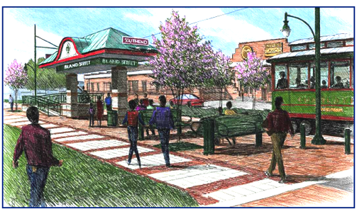
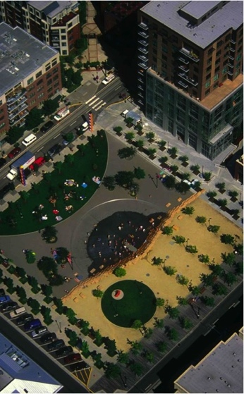
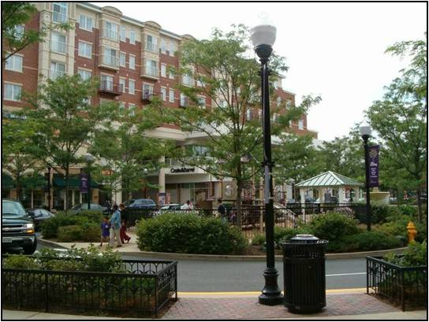
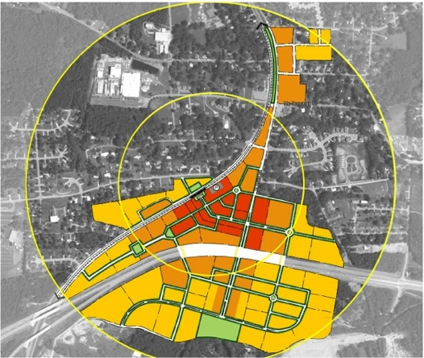
Transit Oriented Developments (TODs)
Compact, walkable, mixed-use community spaces; defined centers
Reinforce traditional neighborhoods
Revitalize by-passed properties
Redefine development patterns
Expand mobility choices; supports bicycling and walking

Slide 37
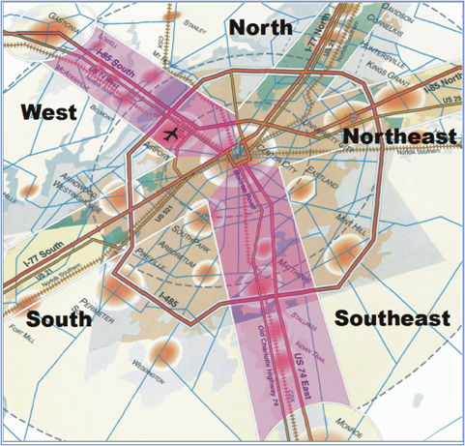
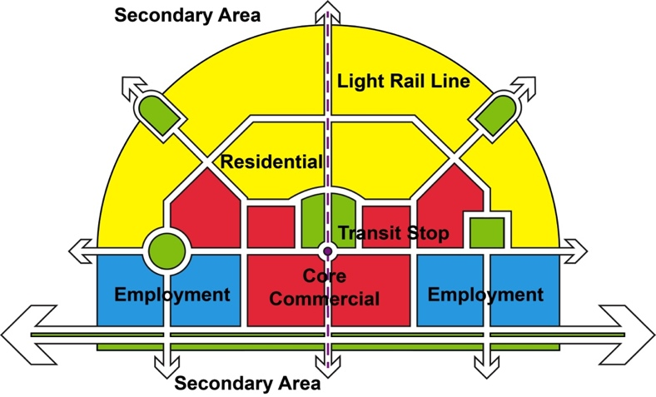
Station Area Planning (SAP)
Station Area Planning (SAP) is the process of planning and designing the community space around transit stations.
SAP facilitates opportunities for community enhancement, growth and development by:
Re-balancing community and mobility needs
Expanding mobility choices
Putting land use goals first, then adding transit
Recognizing the potential for changing regional development patterns
Notes:
Assess the areas around each station within a ¼ and ½ mile radius
Calculate land use capacity of each station area
Vacant properties (blue)
Properties potentially susceptible to change (red)
Develop ratings of High, Medium, and Low for these and related factors
Fairfax area – High
Newtown area – Medium

Slide 38
Oasis Rail Transit – Next Steps
Conduct Station Area Planning – includes workshops with local communities
Continue preliminary engineering/environmental studies
Confirm vehicle type; identify locally-preferred alignment alternatives
Complete draft rail operations and rail systems plans
Prepare capital and operating cost estimates
Complete Business Case Assessment
Complete conceptual financing plan
Coordinate with freight railroads

